Slide 1
BROOKINGS
LATIN- AMERICA ECONOMIC PERSPECTIVES
Mauricio Cárdenas and Eduardo Levy-Yeyati

Slide 2
Outline
Common Threads
Country Vignettes
Argentina: Exhausting margins
Brazil: Growing tensions
Colombia: Success without exuberance
Mexico: Unsettled maturity
Venezuela: Recession or implosion?
Class Rankings

Slide 3
Outline
Common Threads
Country Vignettes
Argentina: Exhausting margins
Brazil: Growing tensions
Colombia: Success without exuberance
Mexico: Unsettled maturity
Venezuela: Recession or implosion?
Class Rankings

Slide 4
Rapidly narrowing output gaps
Percent
Note: Cyclical output based on the log-linear de-trending. Source: Own construction based on Central Bank bulletins and the Economist Intelligence Unit.
Notes:
How much more is needed to unwind?

Slide 5
Reflect limits to non-inflationary growth
Growth decomposition 2000--2007
Percents
Notes: PCE: Peripheral core economies (Australia, Canada, New Zealand, Norway, Sweden).
Source: own calculations based on data from Blyde, Daude and Fernández-Arias (2009).

Slide 6
Global Growth: Reduced Speed Ahead
Note: LAC-7: Argentina, Brazil, Chile, Colombia, Mexico, Peru ,and Venezuela. Other LAC: Costa Rica, Dominican Republic, Ecuador and El Salvador. Source: Own calculation based on data from the Economist Intelligence Unit.

Slide 7
Cautious monetary unwinding is underway…
Inflation (%)
Monetary policy interest rate (%)
Percent
Source: International Monetary Fund, World Economic Outlook; Central Bank bulletins and Economist Intelligence Unit.
Notes:
Central banks have one eye on inflation, and another eye on feeble global demand

Slide 8
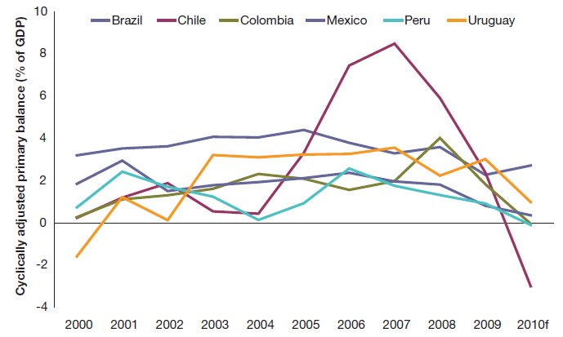
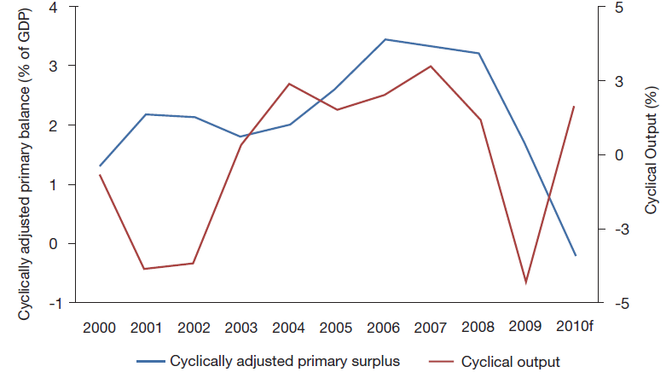
...while fiscal stimulus is still on
The cyclically-adjusted fiscal primary surplus
LAC cyclically-adjusted fiscal surplus and cyclical output
Note: Estimated as the intercept from a regression of the primary surplus on cyclical output, where the latter is obtained from the log-linear de-trending of real GDP. Countries include Argentina, Brazil, Chile, Colombia, Mexico, Peru and Venezuela. Source: Own construction based on Economist Intelligence Unit.

Slide 9
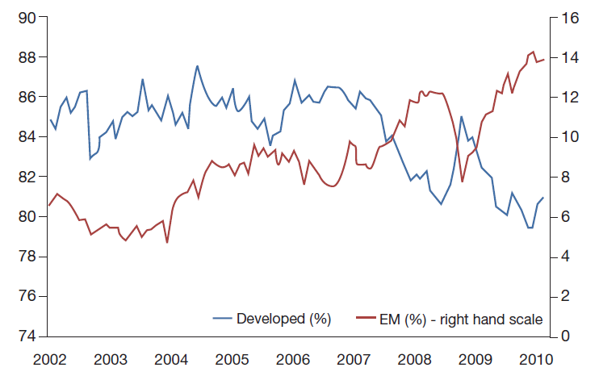
Hello, global equity funds
Shares in total flows
Percent
Percent
Source: own calculations based on EPFR.

Slide 10
Stronger currencies, for now…
2005=100
Source: World Bank’s Global Economic Monitor.

Slide 11
What to do?
Avoid over-appreciation as part of the counter-cyclical response…
…as opposed to undervaluation as a development tool.
Arguments for smoothing-out exchange rates:
Portfolio capital has never applied for permanent residence
QE2 in developed countries is not sustainable in the medium term
Current accounts are expected to deteriorate in LAC
Ultimately, reasonably priced currencies and limited external deficits are the best protection against procyclical flows

Slide 12
What to do?
Save for the rainy days
The region saved in the early 2000s to gain reputation, and spend during the crisis: Will it unwind now that reputation has been built?
Reserves as a form of countercyclical saving
Sterilized interventions generate quasi fiscal losses…but the reversion of the exchange rate during a dollar squeeze recoups valuation losses...
…and lower spreads and investment of reserves in longer-term, higher yielding instruments should reduce carrying costs.

Slide 13
Outline
Common Threads
Country Vignettes
Argentina: Exhausting margins
Brazil: Growing tensions
Colombia: Success without exuberance
Mexico: Unsettled maturity
Venezuela: Recession or implosion?
Class Rankings

Slide 14
Argentina’s confidence may drag down growth momentum
Source: Own calculations based on International Labor Organization, World Bank’s GEM; The Economist Intelligence Unit ; Deloitte Argentina and Universidad Torcuato di Tella-Finance Research Center.

Slide 15
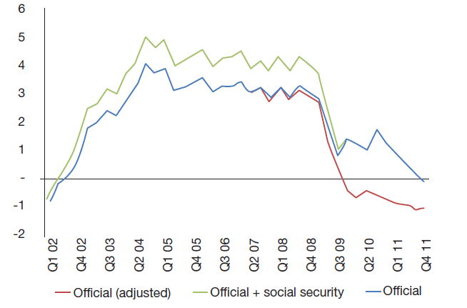
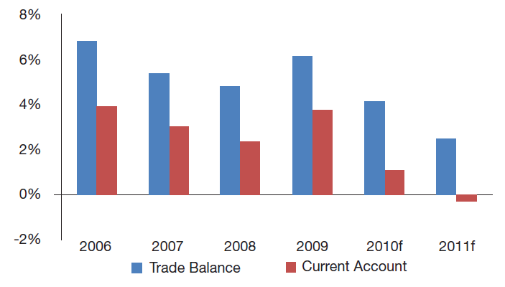
Argentina: Agony of the twin surpluses
Primary fiscal surplus (% GDP)
Current account and trade balance
% GDP
% GDP
Note: Adjusted primary surplus excludes from the official figures the central bank´s quasi fiscal surplus, FGS profits and SDR issuance. Consolidated adds to the official figures the contributions to the social security system allocated to private pension funds prior to the 2008 renationalization. Source: Ministry of Economics, Central Bank of Argentina and INDEC.

Slide 16
Argentina’s inflationary growth: what to expect?
Low real interest rates (+ lack of investment instruments) → Real estate and durables consumption boom
Expansionary fiscal spending (+ wage indexation) → Growing (and latent) inflation
No policy change until the end-2011 election → Political dilemmas
Who will switch to a non-inflationary slower growth path?
How much time can a renewed access to capital markets buy for a smooth transition to sustainable growth?
Binomial scenario
Reelection: Smooth ride into a slow descent
New administration: Near term risks and significant upsides

Slide 17
Brazil: Confidence offsets financial downturn
Source: Own calculations based on International Labor Organization, World Bank’s GEM; The Economist Intelligence Unit and OECD.

Slide 18
Brazil’s policy imperatives
Macroeconomic stability
Social progress (expansion of the middle class)
Active industrial policies (e.g., BNDES)
Is this sustainable?
Taxes are already high
Low hanging social fruit already collected
Development banks will begin to deal with NPLs
Public investment is extremely low

Slide 19
Brazil: reduction in inequality is noteworthy….
Source: Barros, R., de Carvalho, M. , Franco, S., and Mendonça, R. (2010).

Slide 20
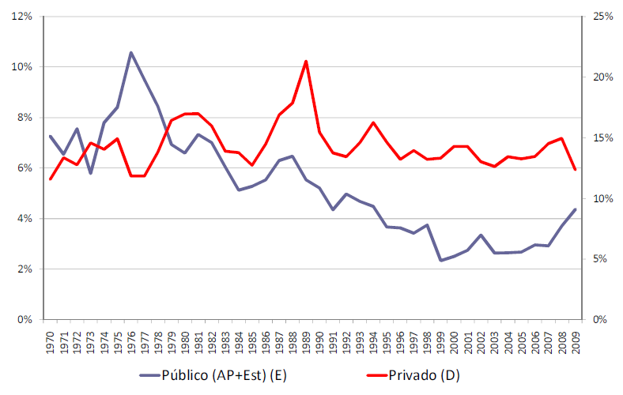
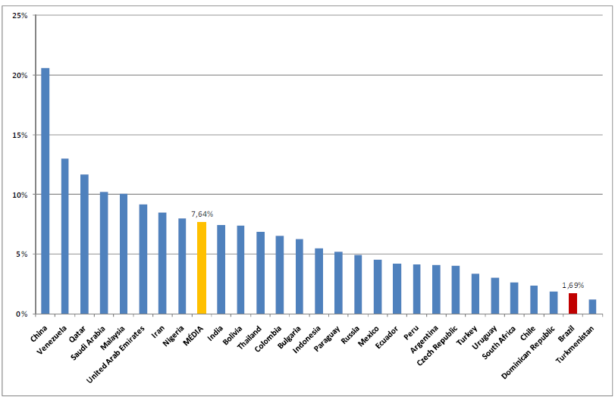
..and so is the very low public investment
% GDP
Brazil
Public
Private
Source: J.R. Afonso (2010) "O Nó dos Investimentos Públicos no Brasil“ based on data from the IMF’s WEO.

Slide 21
Brazil’s low non-inflationary growth: what to do?
High real interest rates → Subsidies to long-term financing (BNDES) → Weak monetary transmission → High interest rates.
Low public (and corporate) investment.
Alternative equilibrium → Redirect BNDES resources to infrastructure → Increase potential growth and create room for lower real interest rates.

Slide 22
Colombia: Consistency without exuberance
Source: Own calculations based on International Labor Organization, World Bank’s GEM; The Economist Intelligence Unit and Fedesarrollo.

Slide 23
Colombia’s main downside: Venezuela
Colombia’s exports to Venezuela up until July, 2010
Source: Fedesarrollo, original source DANE.

Slide 24
Countercyclical policy during the crisis rose public debt
Public debt % GDP- Central Government (net of financial assets)
Source: Fedesarrollo.

Slide 25
Budget Balance (% GDP)- Chile, Colombia and Peru
Source: The Economist Intelligence Unit

Slide 26
Consumer and business confidence
Source: Own construction based on Fedesarrollo.

Slide 27
Colombia’s encouraging medium-term outlook
Continuity has been the trademark of macroeconomic and security policies.
Growth:
Expected to reach 5% in 2011 and remain at same level for next 4-5 years.
Main growth engine: investment→ rates are particularly high: 25% GDP
Major constraint to growth: Infrastructure→ new administration is focusing on closing the gap.
Venezuela is a key market for Colombia, and conditions there remain very unpredictable→ Colombia’s main downside.

Slide 28
Mexico’s real sector index is unsustainably high
Source: Own calculations based on International Labor Organization, World Bank’s GEM; The Economist Intelligence Unit and OECD.

Slide 29
Historically low consumer confidence
Source: Own calculations OECD.

Slide 30
Mexico: unsettled maturity
Subpar economic growth→ average per capita growth 1.6% (1990-2008); 1.3% (1990s); compared with 3.6% in Chile.
Exhaustion of the Cantarell oil field→ 25% decline in oil production between the peak level in 2004 and mid-2009.
Reluctance of offset fiscal loss with additional taxation.
Sectors opened to competition (manufactures, finance, retail, and housing) have experienced much faster growth than sectors where competition has been restrained (telecommunications and energy).

Slide 31
Venezuela’s new equilibrium?
Source: Own calculations based on International Labor Organization and World Bank’s GEM.

Slide 32
Venezuela: chasing capital out
U.S. current dollars
Source: International Monetary Fund’s International Financial Statistics.

Slide 33
Venezuela: Recession or implosion?
Growth (%)
Source: Banco Central de Venezuela.

Slide 34
What’s next in Venezuela?
Radicalization vs. Moderation: Past experience suggests that Chavez is more dogmatic than pragmatic, so hard-line seems more likely.
This means more nationalizations (which now are confiscations) and interference in key markets and sectors.
A currency depreciation seems unavoidable to provide government additional fiscal firepower.
Private sector will not react positively.
Optimism regarding 2012 elections, tamed by tumultuous uncertainty in the next two years.

Slide 35
Regional repercussions
Venezuela’s economy will not recover, affecting growth prospects in Colombia.
Moderate fiscal and monetary unwinding in Colombia, relative to Chile and Peru.
Additional pressures from the private sector in Colombia for policies that restrain the appreciation of the currency.
Problems in Venezuela will affect Petrocaribe’s support to Central American and Caribbean countries, exacerbating problems in many of them, including Cuba.

Slide 36
Outline
Common Threads
Country Vignettes
Argentina: Exhausting margins
Brazil: Growing tensions
Colombia: Success without exuberance
Mexico: Unsettled maturity
Venezuela: Recession or implosion?
Class Rankings

Slide 37
A way to measure progress towards development
Variables used in the rankings:
Real GDP growth
Inflation, average CPI (%)
Cyclically adjusted fiscal balance (%GDP)
Net external debt (%GDP)
Net external financing needs/CAR (%)
Public sector external debt (%GDP)
Emerging market bond spreads (bp)
Gini coefficient (%)
Human development index
Composite world governance indicator
Stable Growth
Policy Track Record
Financial vulnerabilities
Development factors

Slide 38
Graduation scorecard: Core program
Risk adjusted GDP
Risk adjusted CPI
Notes: Risk adjusted GDP is constructed as the mean of the real GDP growth (1999-2009)/standard deviation real GDP growth (1999-2009); Risk adjusted CPI is constructed as the mean of the CPI inflation rate (1999-2009)/standard deviation of the CPI inflation rate (1999-2009)
Source: The Economist Intelligence Unit and IMF World Economic Outlook Data Base, April 2010.

Slide 39
Graduation scorecard: the hard sciences
Cyclically adjusted fiscal balance (%GDP)
World Governance Indicators
Notes: Cyclically adjusted fiscal balance estimated as the intercept from a regression of the primary surplus on cyclical output, where the latter is obtained from the log-linear de-trending of real GDP. The Economist Intelligence Unit and Kaufmann, Kraay and Mastruzzi (2009). Governance Matters VIII

Slide 40
Graduation scorecard: Final report
Sources: The Economist Intelligence Unit; IMF World Economic Outlook, April 2010; Bank of International Settlements; Moody's; World Bank Global Economic Monitor and World Development Indicators; Human Development Report 2009; Kaufmann, D., Kraay, A., Mastruzzi, M. (2009) Governance Matters VIII.

Slide 41
BROOKINGS
LATIN- AMERICA ECONOMIC PERSPECTIVES
Mauricio Cárdenas and Eduardo Levy-Yeyati
Notes:
41

Slide 42
Assessing the recovery: Where are we now?
PCA analysis based on 8 variables
(all monthly, yoy growth, 2000:01-2010:07)
Employment
Import volume
Industrial production volume
GDP (quarterly)
Equity prices
Emerging market bond spreads (bp)
Business confidence surveys (balances)
Consumer confidence surveys (balances)
Real Index
Financial Index
Confidence Index

