Slide 1
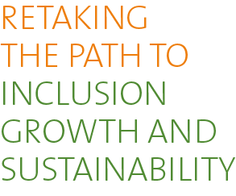
Brazil Systematic Country Diagnostic

Slide 2
What is a Systematic Country Diagnostic?
Analysis by World Bank staff of a country’s main development constraints
Focused on the prospects for the poorest 40% of the population
A diagnostic of constraints not a menu of policy recommendations
Feeds into the Country Partnership Framework – a country strategy document determining World Bank Group activities over a 4-6 year timeframe
It is sent to the World Bank Board for information, but not approval, and subsequently disclosed to the public

Slide 3
Retaking the Path to Inclusion, Growth and Sustainability – Three Messages, Five Challenges
Continued increases in income for the bottom 40 requires the creation of productive jobs and a sustained increased in productivity growth
Fiscal constraints mean that improvements in public services and public investment need to come from reallocation of ineffective spending on the non-poor and efficiency gains
Brazil has the potential to become a leader among emerging markets in green growth
Lack of competition, limited trade and poor business climate
Financial sector distortions
Budget rigidities and waste spending on subsidies and social entitlements have led to unsustainable fiscal situation
Poor governance and political fragmentation weaken efficiency and accountability of spending
Fragmented authority and lack of price signals increase vulnerability to climate shocks, and limit green growth opportunities

Slide 4
The Structure of this Presentation
Brazil’s Achievements
What Went Wrong?
Long-term Structural Constraints in the Way of an Inclusive, Sustainable Growth Path

Slide 5
Brazil’s Achievements

Slide 6
Achievement 1: Solid growth with large reduction in poverty and inequality

Slide 7
Achievement 2: Job creation drove shared prosperity

Slide 8
Achievement 3: Improved access to public services

Slide 9
Achievement 4: Falling inflation and stable public finances (until recently)

Slide 10
Achievement 5: Brazil is a leader in climate change mitigation efforts

Slide 11
What went wrong?

Slide 12
What Went Wrong? A Terms of Trade shock

Slide 13
What Went Wrong? Boom allowed wages to outpace productivity growth

Slide 14
What Went Wrong? Countercyclical policies had limited impact and high fiscal cost
Only earmarked credit expanded after the crisis
Rising fiscal cost but limited impact

Slide 15
What Went Wrong? Fiscal collapse depresses confidence and increases risk premia
Revenues are highly pro-cyclical, spending is rigid
As fiscal picture deteriorates, confidence tanks and risks go up

Slide 16
Long term structural challenges

Slide 17
Long-Term Structural Challenges: Slow productivity growth

Slide 18
Structural challenges for productivity growth: A poor business climate and weak infrastructure

Slide 19
Structural challenges for productivity growth: Little competition and costly finance

Slide 20
Structural Challenges for productivity growth: Another symptom – poor management and inefficient firms
2%

Slide 21
Long-Term Structural Constraints: A large and inefficient state

Slide 22
Long-Term Structural Constraints: Rigid and not pro-poor public spending rules

Slide 23
Long-Term Structural Challenges: Unresolved conflicts and failure of the State

Slide 24
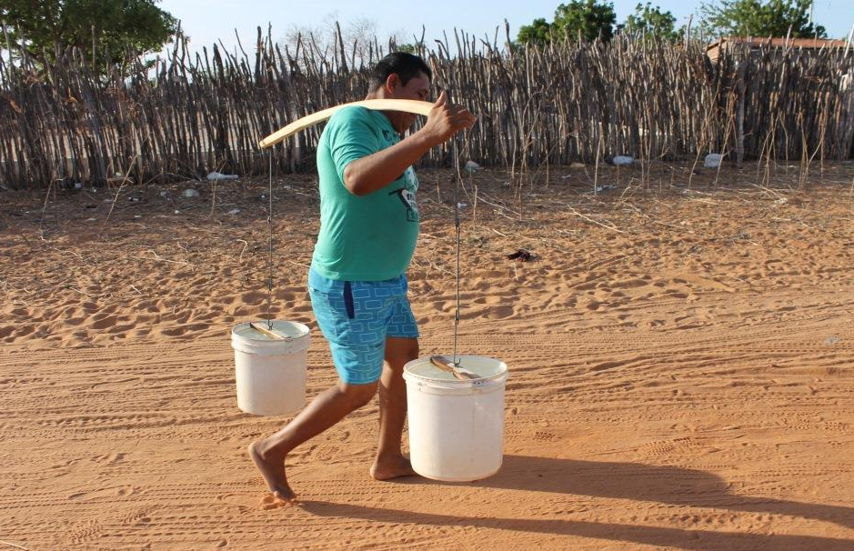
Long-Term Structural Challenge: sustainable development and addressing vulnerability to Climate Change
Increasing scarcity of water

Slide 25
Conclusion: What are the issues?
SCD does not provide detailed policy recommendations but areas to be addressed are clear:
More competition, trade and more liberal finance
Impulse for productive job creation
role for labor market reform and improvement of skills?
Reallocation of spending and stronger accountability & public sector governance (particularly budgetary processes)
Better services, more protection for the poor, less waste and crowding out of private savings and investment
Better planning, coordination and pricing of natural resource use
Exploit Brazil’s green growth potential

Slide 26
Thank you

