Slide 1
BRAZIL’S CURRENT MONETARY
POLICY DILEMMAS
Edmar L. Bacha
Bank of Israel
April 14, 2011

Slide 2

SUMMARY
Brazil’s macroeconomic policy framework
Central Bank status and functions
Economic policy performance
Current economic conditions
Monetary policy objectives and dilemmas with use of overnight interest rate and FX spot market intervention
Search for ‘unorthodox’ policy instruments: credit restrictions, capital controls, and more diversified FX intervention
Evaluation of current ‘unorthodox’ policies

Slide 3
Macroeconomic policy framework since Jan’ 1999
Inflation targeting (currently, 4.5% ± 2.0%)
Floating exchange rates (w/regular CB FX intervention)
Primary (ex-interest) public sector surplus
(2011 target, 3% GDP)

Slide 4
Digression on Central Bank’s status
The CB is an autarky linked to the Ministry of Finance. But the CB Governor is a cabinet level position since 2004, and, thus, responds directly to the President of the Republic. His appointment is approved by the Senate
CB directors (7 to 8) are normally selected by the CB Governor in agreement with the Finance Minister. Subsequently, they are appointed by the President of the Republic, once approved by the Senate. CB Governor and directors can be freely dismissed by the President of the Republic
Currently, the CB Governor and all directors are career civil servants. In previous years, at least some of them were selected in the local financial market or academia
The yearly inflation target range is set for two years ahead by the Monetary Council, composed by the Finance Minister, the Planning Minister, and the CB Governor
The CB’s Monetary Committee (≈ CB board) is responsible to maintain inflation on target. It meets every 45 days to set the SELIC (overnight) interest rate target for the subsequent period
The CB operates in the FX market through electronic auctions open to authorized bank dealers

Slide 5
Economic policy performance
Inflation: target range and actual 12mo inflation
Wages and Unemployment
Exchange rate (BR$/USD) and CB foreign exchange market interventions
Current account deficit, capital inflows and international reserve accumulation
CB international reserves
Primary public sector surplus
Public sector debt/GDP

Slide 6
Inflation
IPCA inflation vs Central Bank target
Source: IBGE

Slide 7
Wages and Unemployment
Real Wage Bill Index – Mar-02=100 - SA
Unemployment rate and NAIRU - % - SA
Brazil’s NAIRU ( non-accelerating inflation rate of unemployment) at close to 7.5%
7.5
6.3
Source: IBGE; Itaú

Slide 8
Exchange rate and CB intervention
BCB’s Intervention in the FX market
Source: BCB; Itaú

Slide 9
Balance of Payments (US$ bn)
Source: BCB

Slide 10
International Reserves
Source: BCB

Slide 11
Public sector primary surplus
Source: National Treasury, Itaú

Slide 12
Public sector debt/GDP
Total Public Debt: Net and Gross (% GDP)
Source: BCB, Itaú

Slide 13
Current economic conditions
Overheated economy
Inflation rate: high and rising
Very high real interest rates
Very appreciated currency
Dependence on commodity-related exports
Rising current account deficit

Slide 14
Overheated economy (growth of domestic demand)
Domestic Demand (12 Months)
Source: IBGE, Itaú

Slide 15
...backed by strong growth of government spending and public banks’ credit expansion
Total Government Expenses (inflation adj. 3-month YoY %)
Outstanding Loans (YoY)
Public Banks
Private Banks
Source: BCB, Itaú

Slide 16
Inflation rate: high and rising (headline and ex-food and beverages)
IPCA Index (12 Months)
Itaú Forecast
5.9%
Source: IBGE, Itaú

Slide 17
High real interest rates (Brazil’s and World’s, since 1996)
50
40
30
20
Brazil
10
0
World
-10
4T-09
2T-10
2T-96
4T-10
4T-96
2T-97
4T-97
2T-98
4T-98
2T-99
4T-99
2T-00
4T-00
2T-01
4T-01
2T-02
4T-02
2T-03
4T-03
2T-04
4T-04
2T-05
4T-05
2T-06
4T-06
2T-07
4T-07
2T-08
4T-08
2T-09
Source: Itaú

Slide 18
Very appreciated currency (Big Mac X-rates)
Big Mac Index 2010
Difference to the US Big Mac (USD)
Country
Dollars
Switzerland
6.78
Brazil
5.26
Euro Area
4.79
Canada
4.18
Israel
4.17
Japan
3.91
United States
3.71
Britain
3.63
Singapore
3.46
South Korea
3.03
South Africa
2.79
Mexico
2.58
Thailand
2.44
Russia
2.39
Malaysia
2.25
China
2.18
Source: The economist

Slide 19
Dependence on commodity-related exports
Main Brazilian Exports - 2010
Exports (USD bn – 12M)
Other
Iron Ore & Metals
Commodities
Meat
Oil, Fuel and
Chemicals
Sugar
and Ethanol
Machines, Equip.
Incl. Electrical
Transport Equip.
Non-commodities
Soya Complex
Source: MDIC

Slide 20
Rising current account deficit
% GDP
Forecasts
Current Account Deficit (12M)
Foreign Direct Investment (12M)
Source: BCB; Itaú

Slide 21
Current monetary policy objectives and dilemmas in the use of the Selic interest rate
Main current policy objective is to cool off the economy to bring inflation back to target
Problem is that fiscal stance and public banks’ credit expansion provide little help to the CB
Raising an interest rate that is already very high is costly and induces further exchange rate appreciation
CB as a consequence is following a gradual path of interest rate tightening, hoping to bring inflation to target by 2012

Slide 22
Gradual monetary tightening
Selic Target Rate
Itaú Forecast
12.25%
11.25%
11.50%
Source: BCB; Itaú

Slide 23
Current monetary policy objectives and dilemmas in the use of FX spot market intervention
Second objective is to prevent FX volatility resulting from ‘speculative’ capital flows – while supposedly not intervening to avoid FX fluctuations related to ‘fundamentals’
(Regressions of the BRL/USD on the CRB commodity price index, the 10y Brazil’s CDS spread over Libor, the DXY index of the dollar against major currencies, and the lagged BRL/USD, yields good statistical results)
This is the FX intervention objective as seen from the CB’s perspective. The Finance Ministry is also concerned with the negative impact on manufacturing of ‘fundamental’ X-rate appreciation ( because of ‘deindustrialization’)
Problem is that sterilized intervention in the FX market is very costly (because of very high domestic interest rates)

Slide 24
Current search for ‘unorthodox’ monetary policy interventions-I
Control of domestic demand through restrictions on domestic credit expansion, introduced as ‘macroprudential measures’ (Dec’03, 2010)
Higher reserve requirements on bank deposits (from 23% to 32% on CDs, and from 51% to 55% on demand deposits)
Higher capital charges on banks’ consumer credit w/maturity over 2 years

Slide 25
Current search for ‘unorthodox’ monetary policy interventions-II
Fighting FX appreciation through capital controls and more diversified FX market intervention
Tax on ‘speculative’ capital inflows (Oct’4 2010: IOF tax up to 4% on fixed income flows from 2% previously; Oct’18, 2010: IOF tax up to 6%, including margin on derivatives)
Restrictions on local banks short spot FX positions (Jan’6, 2011: max exposure, $3 bn)
Intervention in the future FX market (reverse swaps reinitiated on Jan’ 13, 2011)
Intervention in the forward FX market (starting from Jan’25, 2011)
CB FX acquisition for the Treasury (Oct’5, 2011: extension of foreign debt prepayment coverage to 4y from 2y previously) and for the Sovereign Fund (not yet activated)

Slide 26
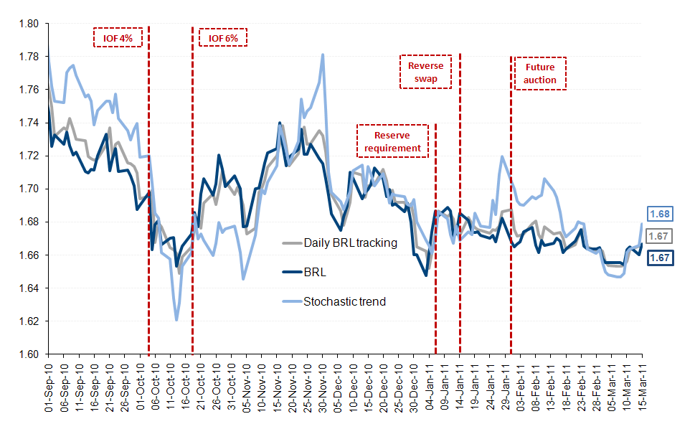
Interventions had little effect...

Slide 27
...or did they have some?
Extended UIP
Source: BCB; Itaú

Slide 28
Evaluation of current ‘unorthodox’ monetary policy stance on demand control
Gradualism in interest rate tightening prolongs inflationary spell and reinforces semi-dormant indexation mechanisms
Restrictions on credit expansion should be designed to ensure financial stability, nor to control domestic demand, as they result in higher distorting bank spreads
It’d be much better to give the monetary authorities power to control the expansion of subsidized credit expansion by the public banks (30% of total)
Economic policy requirements for a lower real ‘equilibrium’ interest rate remain a highly contested academic topic. But a lower public debt and a longer-term commitment to low inflation (as signaled by a more independent CB) would help

Slide 29
Evaluation of current ‘unorthodox’ monetary policy stance: X-rate policy
Preventing FX appreciation is self-defeating because it gives speculators a ‘one side bet’, induces Brazilian firms to borrow abroad, and dampens the FX-channel of inflation control
Interventions in the spot market are very costly to have effective FX impact. Marginal gains of operating futures and forwards seem limited
‘Soft’ capital controls tend to be by-passed in Brazil’s highly sophisticated financial market
‘Hard’ capital controls seem inconsistent with Brazil’s increased openness and need for foreign capital
“Leaning against the wind" (not fixing) may be a good reason to intervene, if there is uncertainty on the future course of ‘fundamentals’ (like commodity prices). Except for this, it seems better to let the X-change appreciate /fluctuate freely to contain speculation, foreign borrowing, and inflation
Abundant international reserves may later be used to smooth the required X-rate devaluation, when-and-if a sudden stop of capital inflows occur

Slide 30
Thanks for helpful discussions to Darwin Dib, Marcio Garcia, Sergio Goldenstein, Ilan Goldfajn, Eduardo Loyo, Alkimar Moura, and Livio Ribeiro. Thanks to Natasha Daher and Italo Franca for research assistance. Graphs 5-12, 14-20 and 26 prepared by the economic team of Banco Itaú Unibanco. Graph 25 prepared by the economic team of Banco BTG Pactual.
TODAH RABBAH

