Slide 1

Brazilian CBDC
The Digital Real
CDPP/IEPE/CdG
Governor
Roberto Campos Neto
September 9, 2021
1

Slide 2

A CBDC for Brazil:
Domestic & Global drivers

Slide 3
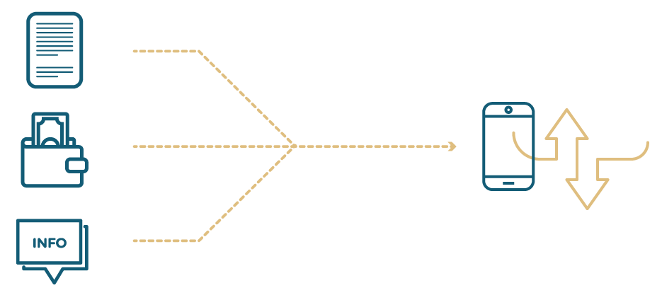
Digital Transformation: Convergence
Text
Financial Innovation
Payments
Intensive use of computational power
Content
3

Slide 4
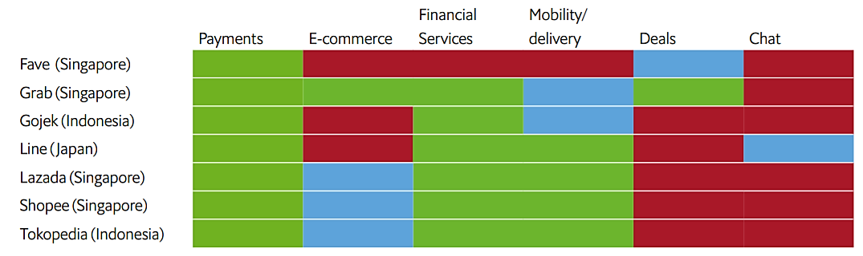
Digital Transformation: Convergence
Payments are the core element of the super-app value proposition in Asia
Note. Mobility / delivery also includes food delivery, ride-hailing and logistics services. Financial services include banking, insurance and investment services. Deals include coupons or discounts on dining, staycation, travel, movies and other lifestyle products.
Sources: Tech in Asia; The Economist Intelligence Unit.
4

Slide 5

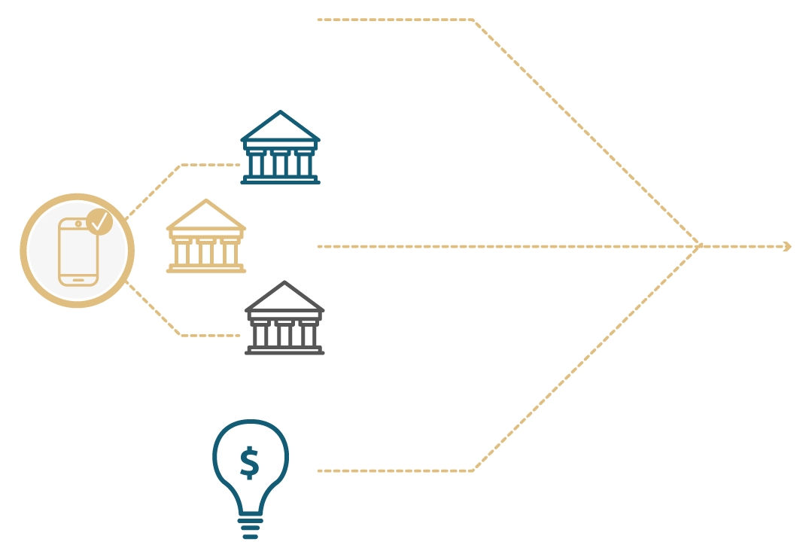
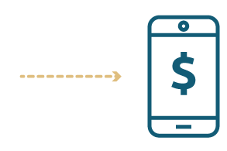
Domestic
Innovation in the financial system
Digital currency
Open Finance
Innovation in currency
5

Slide 6

CBDC around the world
Three kinds of “practical” applications, internationally observed:
Wholesale payments (Europe, Singapore, Switzerland)
Instant payments (Bahamas, China, Sweden)
Fostering new business models (Brazil, Canada, Korea)
6

Slide 7
DeFi markets: a source of inspiration
Opportunities
Reduced transaction costs and friction for:
  designing, distributing, negotiating and settling financial deals
High degree of
  standardization and functional interoperability, reuse and composability of financial services
  auditability, traceability and transparency
  accountability: software-based governance
Financial inclusion
  automatic tools available to everyone, with transparency and non-discriminatory execution
Challenges
Scalability and settlement fees
  blockchain platforms are limiting
Limited interoperability
  blockchains ⇔ traditional financial services
Lack of maturity
  Governance: potential for facilitating the crime of money laundering
  Technology: Operational risks, poor implementation choices, failed software execution and interdependencies
7

Slide 8
DeFi: Architecture
Platforms that aggregate several applications from the previous layer
Aggregation Layer
Aggregator 1
Aggregator 2
Aggregator 3
Development of user-oriented applications
Application Layer
Standardizations for specific business models
Protocol Layer
Exchange
Lending
Derivatives
Asset Management
...
Standards for issuing tokens representing financial instruments
Asset Layer
Native protocol asset
Fungible tokens
Non-fungible tokens
...
Blockchain and its native token
Settlement layer
Blockchain
8

Slide 9
A CBDC for Brazil:
The Digital Real

Slide 10

CBDC
A CBDC for Brazil – The Digital Real
Policy objectives
Innovation and competition in a digital economy
Improved cross-border payments
Reduction in the use of cash
10

Slide 11
CBDC
A CBDC for Brazil – The Digital Real
Challenges
Must enable uses that go beyond the payment solutions we have available today.
  It should take advantage of the business ecosystem we expect to emerge from the open banking.
  Demand already exists – Lift and Regulatory Sandbox.
Depends upon maturation
  BC# Agenda Internal markets International discussion
11

Slide 12
CBDC
A CBDC for Brazil – The Digital Real
An instrument for the BCB to fulfill its mission in a digital economy
Guidelines:
Extension of the Brazilian real
  - Emission by BCB
  - Custody and distribution by the payment system
Retail payments
  - On-line and, eventually, off-line
Innovative models development
  - programmable money, smart contracts, IoT
Non interest-bearing
Guarantee of legal certainty
Data privacy and security
  - Bank secrecy and Brazilian General Data Protection Act
Preventing and combating money laundering
  - Compliance with court orders to track illicit transactions
Interoperability and integration
  - Cross-border payments
High cyber resilience
12

Slide 13
CBDC
A CBDC for Brazil – The Digital Real
Risk: disintermediation
CBDC Dilemma:
How to promote widespread use without pushing the system towards narrow banking?
Digital Real Dilemma:
How to provide liquidity to foster innovation without pushing the system towards narrow banking?
13

Slide 14
CBDC
A CBDC for Brazil – The Digital Real
Digital Real Dilemma
CBDC Shadowing
Banks could be allowed to issue deposits based on the amount of their own deposits transformed in CBDC to access programable money and smart contracts functionalities.
Possible solutions
Regulated liabilities network
Banks could be allowed to tokenize deposits to be used in a new platform of intermediation, together with a CBDC, with access to programable money and smart contracts functionalities.
14

Slide 15



CBDC
A CBDC for Brazil – The Digital Real
DLT vs Centralized
Guidelines | DLT | Centralized
New business models |  | Is it flexible enough
Retail payments | Lack of scalability
Two-tier system
Non interest-bearing
Bank secrecy and Privacy | More players with data access
AML
Cross-border payments | Dependent on technology coordination | Dependent on technology coordination
Cyber resilience | Lack of certified professionals Larger attack surface | Internal attacks
15

Slide 16

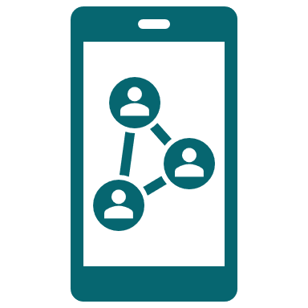

CBDC
A CBDC for Brazil – The Digital Real
Next steps
Debate on established guidelines
Pace of implementation
Society's perception of applicable technologies and use cases
2022: PoC / Innovation lab; 2023: Pilots; 2024: Decisions
16

Slide 17


Thanks
Follow the BCB on social media
Register to receive our newsletter
comunicacao@bcb.gov.br

